Slide 1

UNIVERSITY INSTITUTE OF ENGINEERING
DEPARTMENT OF COMPUTER SCIENCE & ENGINEERING
Master of Engineering (Computer Science & Engineering)
Subject Name : Soft Computing
Department: CSE
Prepared By: Er. Komal Sharma.
DISCOVER . LEARN . EMPOWER

Slide 2
COURSE DESCRIPTION
Soft Comtuting is everywhere.
An umbrella term used to describe types of algorithms that produce approximate solutions to unsolvable high-level problems in computer science.

Slide 3
COURSE OBJECTIVES
To understand soft computing concepts and techniques
To foster their abilities in designing and implementing soft computing based solutions for real-world and engineering problems.
To Introduce students to fuzzy systems, fuzzy logic and its applications.
To Provide the mathematical background for carrying out the optimization associated with neural network learning.

Slide 4
COURSE OUTCOMES
On completion of this course, the students are expected to have learnt about the following:
C01 | Describe familiarity with the basic concepts related to soft computing
CO2 | Illustrate various fuzzy lgic functions
CO3 | Analyze numerous artificial neural network types
CO4 | Outline fundamental concepts of genetic algorithms in machine learning
CO5 | Develop hybrid nature of FIS techniques to real world problems by extending the capabilities of existing technology

Slide 5
Chapter 1.1.3
What is Fuzzy Logic?
The 'Fuzzy' word means the things that are not clear or are vague. Sometimes, we cannot decide in real life that the given problem or statement is either true or false. At that time, this concept provides many values between the true and false and gives the flexibility to find the best solution to that problem.

Slide 6
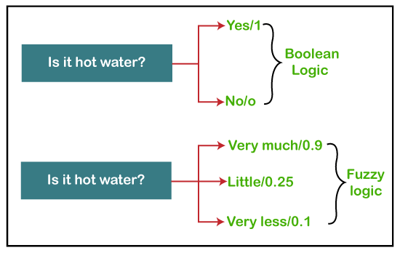
Chapter 1.1.3
Example of Fuzzy Logic as comparing to Boolean Logic:

Slide 7
Chapter 1.1.3
Fuzzy Logic(Cont…..)
Fuzzy logic contains the multiple logical values and these values are the truth values of a variable or problem between 0 and 1. This concept was introduced by Lofti Zadeh in 1965 based on the Fuzzy Set Theory. This concept provides the possibilities which are not given by computers, but similar to the range of possibilities generated by humans.
In the Boolean system, only two possibilities (0 and 1) exist, where 1 denotes the absolute truth value and 0 denotes the absolute false value. But in the fuzzy system, there are multiple possibilities present between the 0 and 1, which are partially false and partially true.
The Fuzzy logic can be implemented in systems such as micro-controllers, workstation-based or large network-based systems for achieving the definite output. It can also be implemented in both hardware or software.

Slide 8
Chapter 1.1.3
Characteristics of Fuzzy Logic
Following are the characteristics of fuzzy logic:
This concept is flexible and we can easily understand and implement it.
It is used for helping the minimization of the logics created by the human.
It is the best method for finding the solution of those problems which are suitable for approximate or uncertain reasoning.
It always offers two values, which denote the two possible solutions for a problem and statement.
It allows users to build or create the functions which are non-linear of arbitrary complexity.
In fuzzy logic, everything is a matter of degree.
In the Fuzzy logic, any system which is logical can be easily fuzzified.
It is based on natural language processing.
It is also used by the quantitative analysts for improving their algorithm's execution.
It also allows users to integrate with the programming.

Slide 9
Chapter 1.1.4
Architecture of a Fuzzy Logic System
In the architecture of the Fuzzy Logic system, each component plays an important role. The architecture consists of the different four components which are given below.
Rule Base
Fuzzification
Inference Engine
Defuzzification

Slide 10
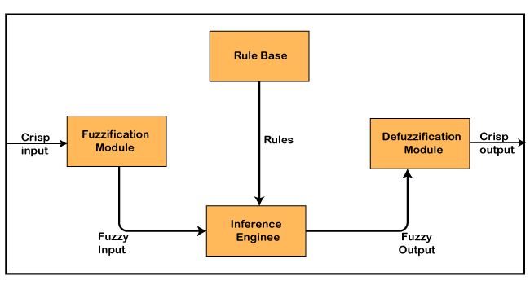
Chapter 1.1.4
Architecture of a Fuzzy Logic System(Cont…..)

Slide 11
Chapter 1.1.4
Architecture of a Fuzzy Logic System(Cont…..)
1. Rule Base
Rule Base is a component used for storing the set of rules and the If-Then conditions given by the experts are used for controlling the decision-making systems. There are so many updates that come in the Fuzzy theory recently, which offers effective methods for designing and tuning of fuzzy controllers. These updates or developments decreases the number of fuzzy set of rules.
2. Fuzzification
Fuzzification is a module or component for transforming the system inputs, i.e., it converts the crisp number into fuzzy steps. The crisp numbers are those inputs which are measured by the sensors and then fuzzification passed them into the control systems for further processing. This component divides the input signals into following five states in any Fuzzy Logic system:

Slide 12
Chapter 1.1.4
Architecture of a Fuzzy Logic System(Cont…..)
Large Positive (LP)
Medium Positive (MP)
Small (S)
Medium Negative (MN)
Large negative (LN)
3. Inference Engine
This component is a main component in any Fuzzy Logic system (FLS), because all the information is processed in the Inference Engine. It allows users to find the matching degree between the current fuzzy input and the rules. After the matching degree, this system determines which rule is to be added according to the given input field. When all rules are fired, then they are combined for developing the control actions.
4. Defuzzification
Defuzzification is a module or component, which takes the fuzzy set inputs generated by the Inference Engine, and then transforms them into a crisp value. It is the last step in the process of a fuzzy logic system. The crisp value is a type of value which is acceptable by the user. Various techniques are present to do this, but the user has to select the best one fo

